Slide 1
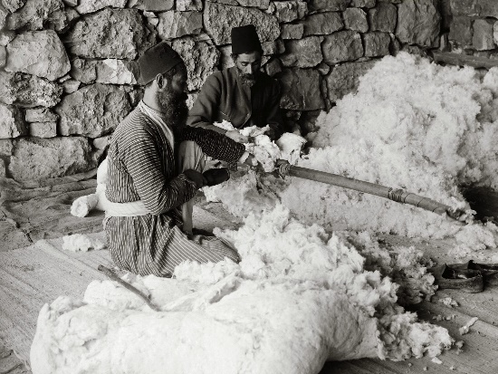
Jews carding cotton
The American Colony and Eric Matson Collection
©2009 Todd Bolen / LifeintheHolyLand.com

Slide 2
2 Thessalonians 3.6-10 NIV: In the name of the Lord Jesus Christ, we command you, brothers and sisters, to keep away from every believer who is idle and disruptive and does not live according to the teaching you received from us. For you yourselves know how you ought to follow our example. We were not idle when we were with you, nor did we eat anyone's food without paying for it. On the contrary, we worked night and day, laboring and toiling so that we would not be a burden to any of you. We did this, not because we do not have the right to such help, but in order to offer ourselves as a model for you to imitate. For even when we were with you, we gave you this rule: “The one who is unwilling to work shall not eat.”

Slide 3
For even when we were with you, we gave you this rule: “The one who is unwilling to work shall not eat.”

Slide 4
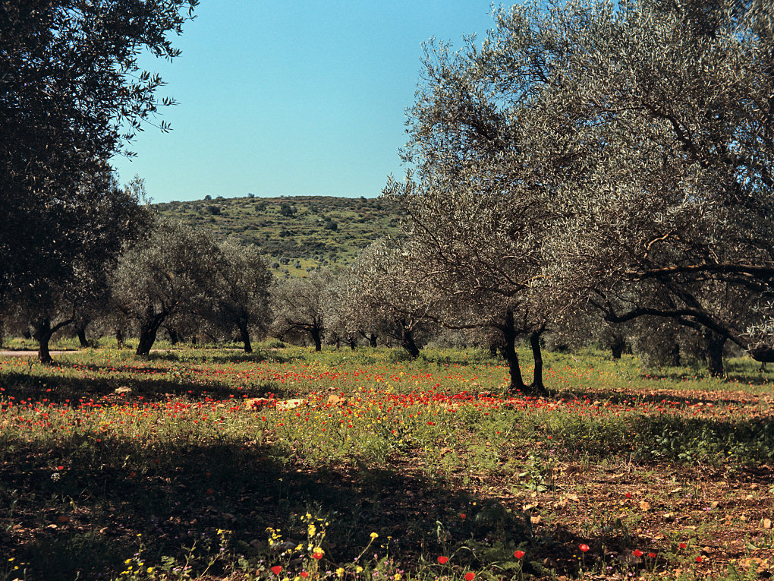
Genesis 2.15 NIV: The LORD God took the man and put him in the Garden of Eden to work it and take care of it.
olive trees and flowers in Galilee
Views That Have Vanished: The Photographs of David Biven
©2008 Todd Bolen / LifeintheHolyLand.com

Slide 5
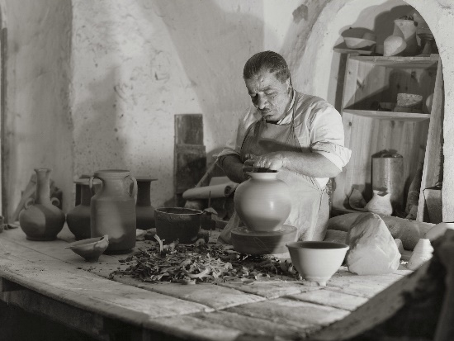
Potter at his lathe wheel
The American Colony and Eric Matson Collection
©2009 Todd Bolen / LifeintheHolyLand.com

Slide 6
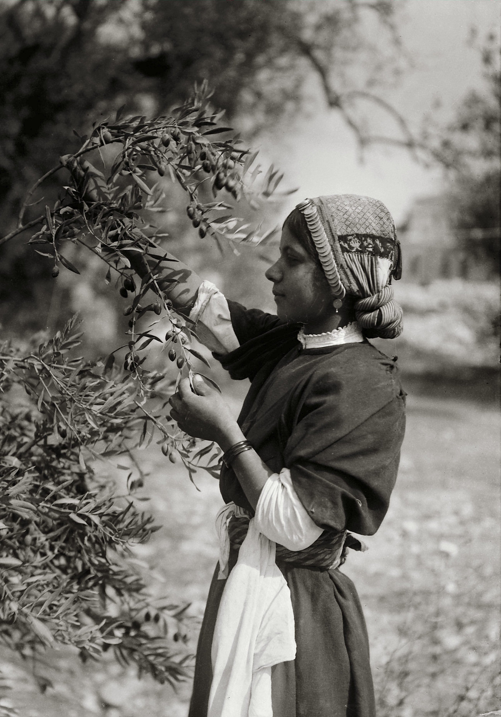
The American Colony and Eric Matson Collection
©2009 Todd Bolen / LifeintheHolyLand.com
Colossians 3.22-25 NET: Slaves, obey your earthly masters in every respect, not only when they are watching– like those who are strictly people-pleasers– but with a sincere heart, fearing the Lord. Whatever you are doing, work at it with enthusiasm, as to the Lord and not for people, because you know that you will receive your inheritance from the Lord as the reward. Serve the Lord Christ. For the one who does wrong will be repaid for his wrong, and there are no exceptions.

Slide 7
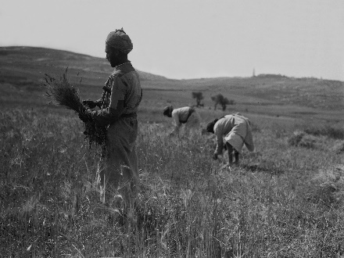
The American Colony and Eric Matson Collection
©2009 Todd Bolen / LifeintheHolyLand.com
Proverbs 6.6-11 NIV: Go to the ant, you sluggard; consider its ways and be wise! It has no commander, no overseer or ruler, yet it stores its provisions in summer and gathers its food at harvest. How long will you lie there, you sluggard? When will you get up from your sleep? A little sleep, a little slumber, a little folding of the hands to rest-- and poverty will come on you like a thief and scarcity like an armed man.

Slide 8
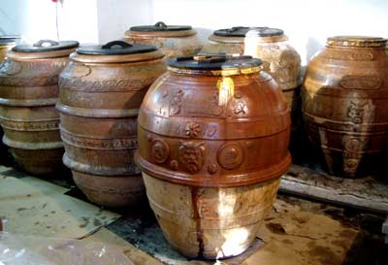
Proverbs 21.20 NIV: The wise store up choice food and olive oil, but fools gulp theirs down.
Antique olive oil jars / FrantoioMacianti.com

Slide 9
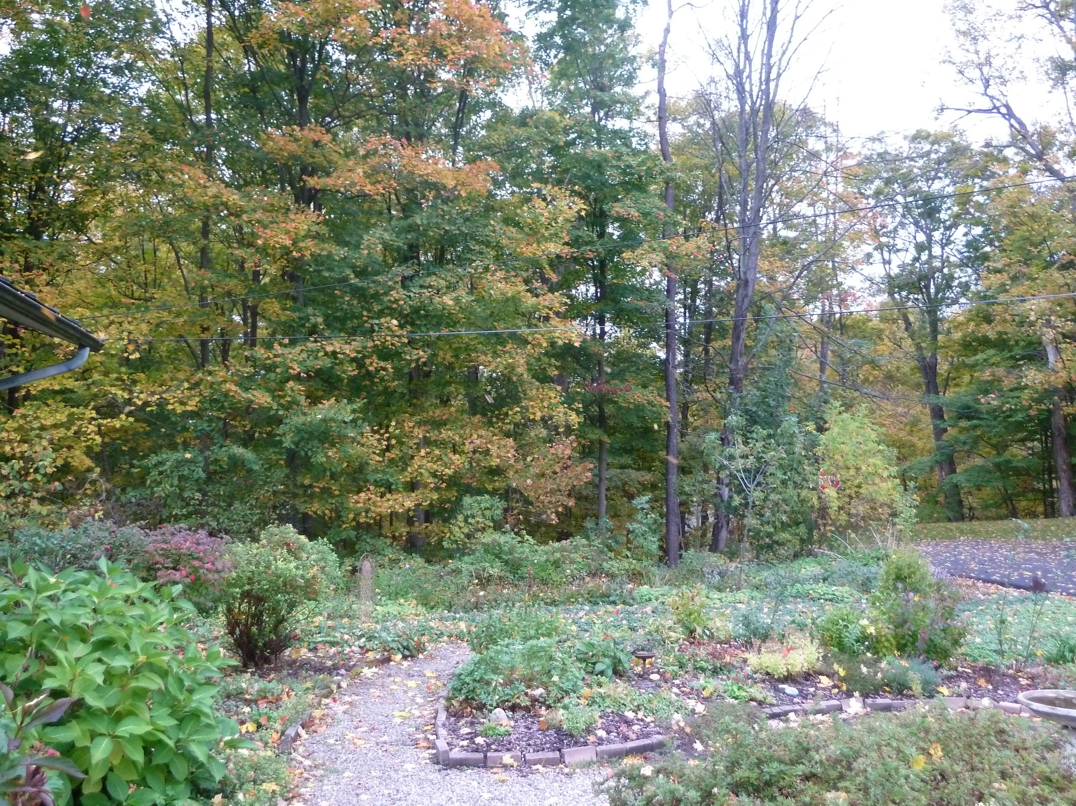
Proverbs 13.22a NIV: A good person leaves an inheritance for their children's children…
Will’s mother’s garden and woods

Slide 10
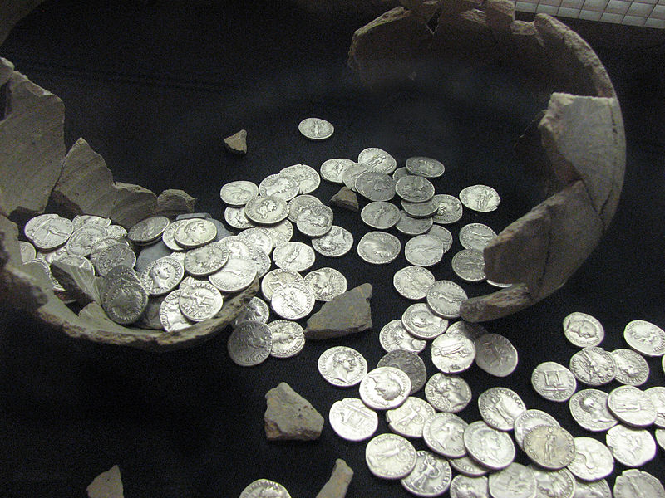
Proverbs 22.7 NET: The rich rule over the poor, and the borrower is servant to the lender.
commons.Wikimedia.org

Slide 11
Deuteronomy 23.19-20 NET: You must not charge interest on a loan to your fellow Israelite, whether on money, food, or anything else that has been loaned with interest. You may lend with interest to a foreigner, but not to your fellow Israelite…
Leviticus 25.35-37 NIV: If any of your fellow Israelites become poor and are unable to support themselves among you, help them as you would a foreigner and stranger, so they can continue to live among you. Do not take interest or any profit from them, but fear your God, so that they may continue to live among you. You must not lend them money at interest or sell them food at a profit.

Slide 12
Borrowing to buy a house could lead to building equity while lowering your housing payment.
This might be true for buying a car, but it usually is better to pay cash for an older car and save for the next rather than borrow to buy new.
Borrowing to finance living expenses is not good.
➔ Pay off credit card balances every month if you can
Compare mortgage rates around 4% with credit card rates around 16%!

Slide 13
Income: Wages
Housing: Rent/mortgage
Insurance, taxes
Maintenance, repairs
Utilities
Car: Car payment
Insurance, tags, AAA
Maintenance, repairs
Gasoline
Giving: Giving to the church
Giving to other charities…

